Slide 1
Environmental issues around livestock in Uganda
Author: Pius Lutakome
Position: CRP Country Coordinator
Email: P.Lutakome@cgiar.org
Date: 19th June 2020

Slide 2
Importance of Pig enterprises in Uganda
Livestock provides food and nutrition security and incomes to the livelihoods of rural communities.
Priority livestock enterprises are cattle, goats and sheep, chicken, pigs, and apiary.
Cattle contribute 40% to the value of livestock production and about 7% to the value of agricultural production.
The contribution of goats and sheep meat production as well as pig and chicken meat production to the agricultural GDP is not clearly defined.
About 17.8% of all households ( about 1.1 million people) are engaged in pig production, but this is more pronounced among female-headed households.
Notes:
Discuss on one of the enterprises:
How much does it contribute to GDP?
How many people are involved in the country?

Slide 3
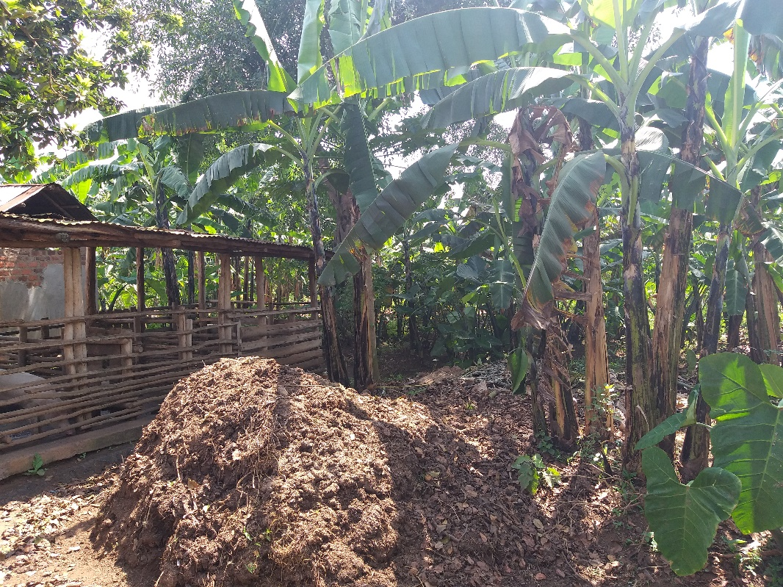
Livestock masters plans and future projections
No master plan for livestock is in existence-missing link.
Growth in pig population is on an upward trend since 2008 reaching 8.0 million in 2019.
Development of a pro-environment pig industry requires concerted efforts and meaningful collaboration among all policymakers, research and development partners involved in livestock to build capacity of key actors in the pig value chain
Notes:
Change the photo:
Are the any masters plans for livestock or big implementation policies in the country? If yes kindly state and if possible a link to the master plan (if you have it on hard copy send that through)
What are the key messages for development? Grow by what percentage? To achieve what?

Slide 4
Livestock & Environment challenges and opportunities
Poor manure management practices, due to inadequate labour and technology to handle and dispose pig waste, compromise on ecosystem health.
Emission of GHGs in the pig-related enterprises is not well understood in Uganda
Pig value chain is largely unorganized operating in an informal market system, compounded by a weak legal and regulatory framework.
Existence of some policy guidelines e.g., the National Environment Policy, the National Land Use Policy, and the National Adaptation Program of Action 2016.
Existence of a good partnership landscape in livestock research and development
Prevailing good environment provided by a stable political situation across the country.
Notes:
Name the key environmental challenges from the livestock sector ( 2 should suffice)
Are there ways to mitigate these challenges (e.g better feeds, biogas etc), current innovations/technologies

Slide 5
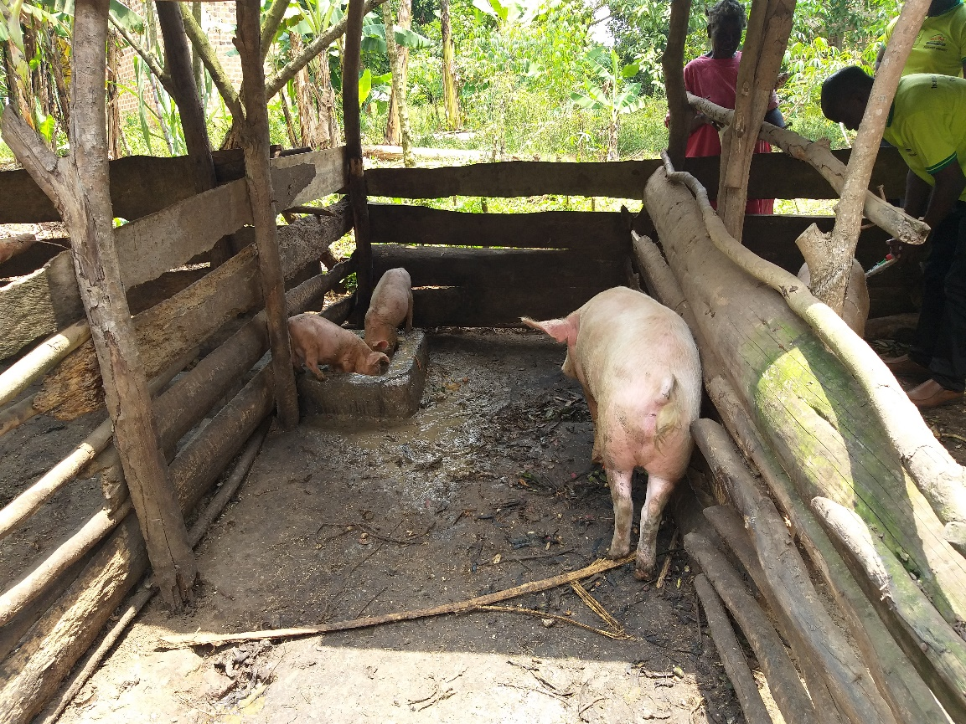
Country Environmental Benchmarks
No clear country specific strategies targeted towards ensuring a carbon neutral pig value chain.
Detailed pig value chain analysis is needed to provide info on input-output flows of pork products at each stage and the associated environmental effects of products.
Notes:
Are there specific country targets to lower environmental impacts . E.g. Carbon emissions, soil erosion.
Discuss 2 points

Slide 6
Thank you!
Author: Pius Lutakome
Position: Livestock Research Specialist
Email: P.Lutakome@cgiar.org

